Slide 1
Computer Graphics Mini Project CSE2066
By
Under the supervision of
Mr. Madhusudhana Reddy-Asst.Prof-CSE Department of CSE Engineering
Name | Roll Number
SAGAR G | 20211ISE0049
CHETHAN D N | 20211ISE0052
NIKHIL M S | 20211ISE0054
RAJAVARDHAN R | 20211IST0018

Slide 2
INTRODUCTION:
2D graphics models may combine geometric models (also called vector graphics), digital images (also called raster graphics), text to be typeset (defined by content, font style and size, color, position, and orientation), mathematical functions and equations, and more. These components can be modified and manipulated by two-dimensional geometric transformations such as translation, rotation, and scaling. In object-oriented graphics, the image is described indirectly by an object endowed with a self-rendering method—a procedure that assigns colors to the image pixels by an arbitrary algorithm. Complex models can be built by combining simpler objects, in the paradigms of object-oriented programming.

Slide 3
Algorithms used:
#include <windows.h>
#include <gl/gl.h>
LRESULT CALLBACK WindowProc(HWND, UINT, WPARAM, LPARAM);
void EnableOpenGL(HWND hwnd, HDC*, HGLRC*);
void DisableOpenGL(HWND, HDC, HGLRC);
int WINAPI WinMain(HINSTANCE hInstance,
HINSTANCE hPrevInstance,
LPSTR lpCmdLine,
int nCmdShow)

Slide 4
if (!RegisterClassEx(&wcex))
return 0;
/* create main window */
hwnd = CreateWindowEx(0,
"GLSample",
"OpenGL Sample",
WS_OVERLAPPEDWINDOW,
CW_USEDEFAULT,
CW_USEDEFAULT,
256,
256,
NULL,
NULL,
hInstance,
NULL);
ShowWindow(hwnd, nCmdShow);
/* enable OpenGL for the window */
EnableOpenGL(hwnd, &hDC, &hRC);
{
WNDCLASSEX wcex;
HWND hwnd;
HDC hDC;
HGLRC hRC;
MSG msg;
BOOL bQuit = FALSE;
float theta = 0.0f;
/* register window class */
wcex.cbSize = sizeof(WNDCLASSEX);
wcex.style = CS_OWNDC;
wcex.lpfnWndProc = WindowProc;
wcex.cbClsExtra = 0;
wcex.cbWndExtra = 0;
wcex.hInstance = hInstance;
wcex.hIcon = LoadIcon(NULL, IDI_APPLICATION);

Slide 5
/* program main loop */
while (!bQuit)
{
/* check for messages */
if (PeekMessage(&msg, NULL, 0, 0, PM_REMOVE))
{
/* handle or dispatch messages */
if (msg.message == WM_QUIT)
{
bQuit = TRUE;
}
else
{
TranslateMessage(&msg);
DispatchMessage(&msg);
}
}
else
{
/* OpenGL animation code goes here */
glClearColor(0.0f, 0.0f, 0.0f, 0.0f);
glClear(GL_COLOR_BUFFER_BIT);
glPushMatrix();
glRotatef(theta, 0.0f, 0.0f, 1.0f);
glBegin(GL_TRIANGLES);
glColor3f(1.0f, 0.0f, 0.0f); glVertex2f(0.0f, 1.0f);
glColor3f(0.0f, 1.0f, 0.0f); glVertex2f(0.87f, -0.5f);
glColor3f(0.0f, 0.0f, 1.0f); glVertex2f(-0.87f, -0.5f);
glEnd();
glPopMatrix();
SwapBuffers(hDC);
theta += 1.0f;
Sleep (1);
}
}

Slide 6
/* shutdown OpenGL */
DisableOpenGL(hwnd, hDC, hRC);a
/* destroy the window explicitly */
DestroyWindow(hwnd);
return msg.wParam;
}
LRESULT CALLBACK WindowProc(HWND hwnd, UINT uMsg, WPARAM wParam, LPARAM lParam)
{
switch (uMsg)
{
case WM_CLOSE:
PostQuitMessage(0);
break;
case WM_DESTROY:
return 0;
case WM_KEYDOWN:
{
switch (wParam)
{
case VK_ESCAPE:
PostQuitMessage(0);
break;
}
}
break;
default:
return DefWindowProc(hwnd, uMsg, wParam, lParam);
}
return 0;
}
void EnableOpenGL(HWND hwnd, HDC* hDC, HGLRC* hRC)
{
PIXELFORMATDESCRIPTOR pfd;
int iFormat;

Slide 7
/* get the device context (DC) */
*hDC = GetDC(hwnd);
/* set the pixel format for the DC */
ZeroMemory(&pfd, sizeof(pfd));
pfd.nSize = sizeof(pfd);
pfd.nVersion = 1;
pfd.dwFlags = PFD_DRAW_TO_WINDOW |
PFD_SUPPORT_OPENGL | PFD_DOUBLEBUFFER;
pfd.iPixelType = PFD_TYPE_RGBA;
pfd.cColorBits = 24;
pfd.cDepthBits = 16;
pfd.iLayerType = PFD_MAIN_PLANE;
iFormat = ChoosePixelFormat(*hDC, &pfd);
SetPixelFormat(*hDC, iFormat, &pfd);
/* create and enable the render context (RC) */
*hRC = wglCreateContext(*hDC);
wglMakeCurrent(*hDC, *hRC);
}
void DisableOpenGL (HWND hwnd, HDC hDC, HGLRC hRC)
{
wglMakeCurrent(NULL, NULL);
wglDeleteContext(hRC);
ReleaseDC(hwnd, hDC);
}

Slide 8
APPLICATIONS:
2D computer graphics are mainly used in applications that were originally developed upon traditional printing and drawing technologies, such as typography, cartography, technical drawing, advertising, etc. In those applications, the two-dimensional image is not just a representation of a real-world object, but an independent artifact with added semantic value.
In many domains, such as desktop publishing, engineering, and business, a description of a document based on 2D computer graphics techniques can be much smaller than the corresponding digital image—often by a factor of 1/1000 or more.

Slide 9
LIMITATIONS:
Limited imagination.
Lack of simplicity .
2D is older less interesting, and less sought out than 3D animation. It is the less desirable of the two technologies and, despite the quick learning time, can take more time to produce in entirety than 3D since the program 2D is built on is less advanced..

Slide 10
SUMMARY:
A 2d design professional draws 2-dimensional, or flat, images used in mechanical drawings, electrical engineering projects, video games, animation, clothing construction and architecture. Professionals working in 2d design use a combination of drawing skills and computer-aided drafting technology to create images for plans, brochures, websites and other products. They may meet with clients to determine design specifications, draw images, layout designs, interact with artists and photographers, work with writers to incorporate text and oversee printing processes used to complete a project. Some 2d design professionals work as independent contractors; other possible employers include engineering firms, municipal planning agencies, power plants, graphic design companies, animation studios and video game developers.

Slide 11
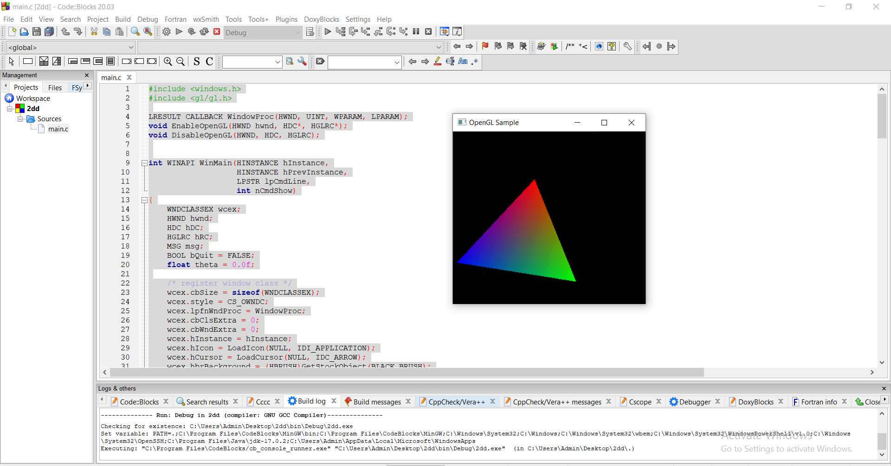

Slide 12
REFERENCE:
https://github.com/rubenandrebarreiro/2d-rotative-shapes-dance
https://github.com/BhaskarVeduruparthi/2D-Rotation-of-a-Wheel/blob/main/computergraphicsproject.cpp
https://www.geeksforgeeks.org/2d-transformation-in-computer-graphics-set-1-scaling-of-objects/?ref=rp

